Slide 1
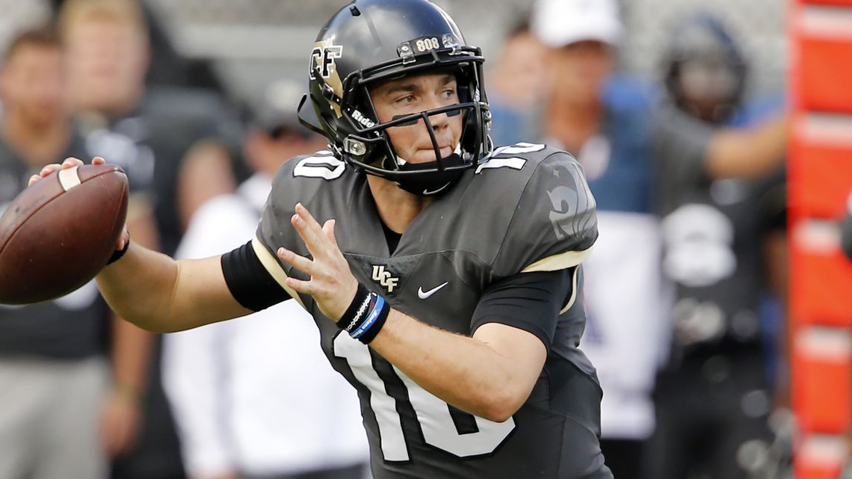

Team McQuarantine Milton
IDS 6916

Slide 2
Introduction
COVID is reshaping our lives from daily human interaction to the economy
COVID transmission mitigation strategies vary by
Government
Location
Profession
Organization
Individual risk tolerance
Who makes the mitigation decision?
Is it based on data?
Are decisions balancing risk vs reward?

Slide 3
Purpose
The purpose of the research is to determine if UCF football game attendance COVID countermeasures are appropriate in minimizing virus spread potential while maximizing attendance revenue.
Using an agent-based model, the study will determine predicted COVID transmission under current UCF football countermeasures and investigate higher attendance numbers under current mitigation strategies to determine if higher revenue is possible with nominal risk.

Slide 4
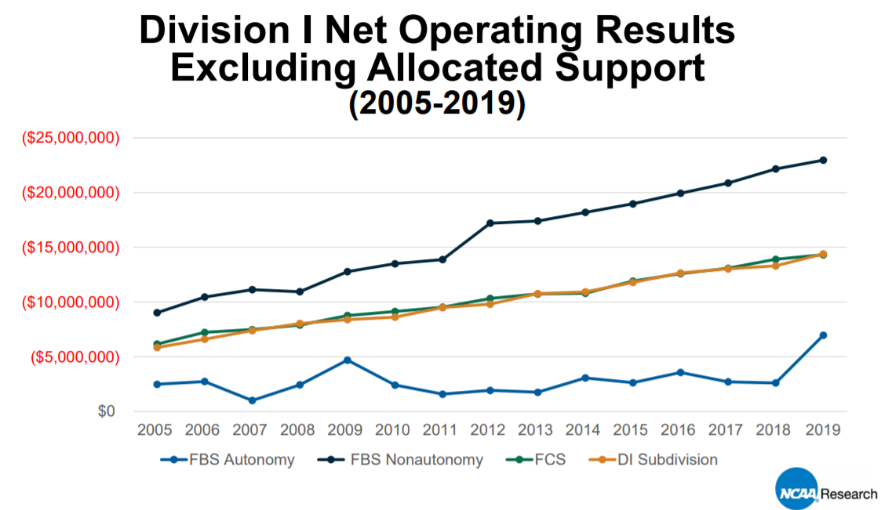
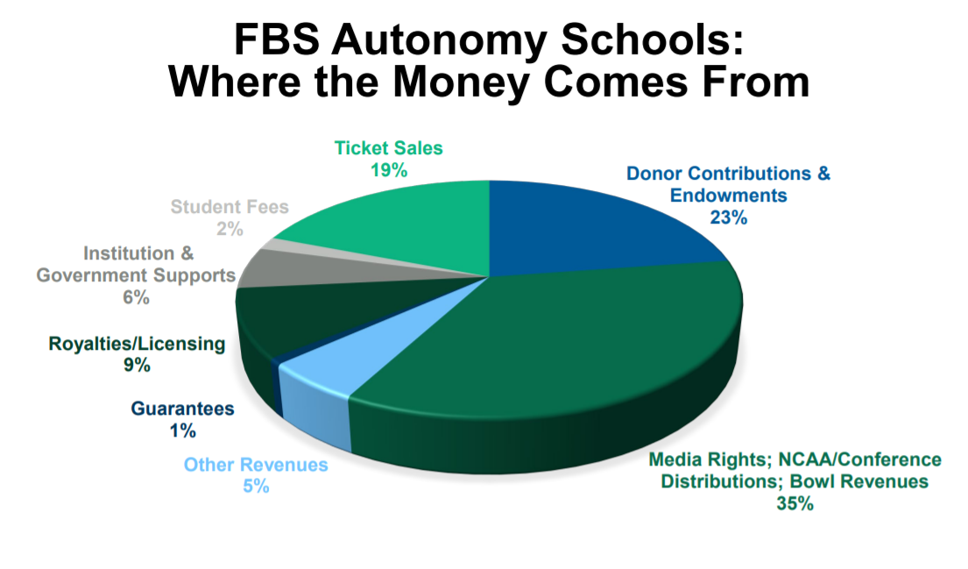
Context
At 25% capacity, reduced ticket sales will equate to a $3,719,552 loss in revenue for UCF (out of a 70m budget).
Our research suggests the 25% capacity limitation is not driven by data or science.

Slide 5


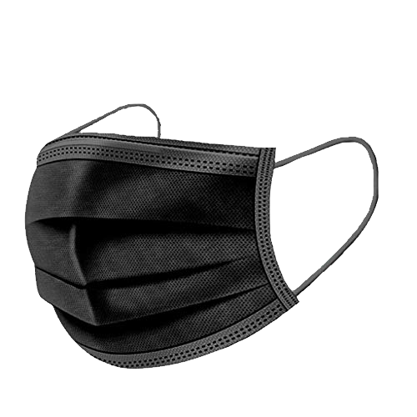

Research question
Are current COVID football attendance limitation and social distancing strategies appropriate for maximizing attendance and minimizing transmission risk, while controlling for the masked COVID transmission rate?
 | VARIABLES
Independent | Dependent | Control
Stadium capacity and social distancing (group size), group strategy | transmission rate, number of contacts | Masked interpersonal transmission rate

Slide 6
Hypothesis
The number of expected infections proportional to the squared value of the attendance.
The group size does affect the number of infections (or number of contacts).
The number of expected infections is proportional to the group size.
The number of infections is not proportional to attendance capacity

Slide 7
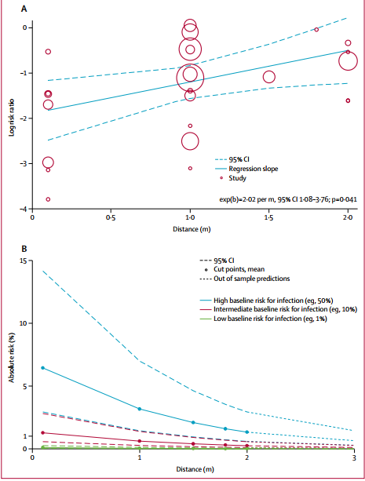
Lit Highlights
Chu et al. (2020) - large meta-analysis paper identifying 172 observational studies across 16 countries, six continents, with no randomized controlled trials and 44 relevant comparative studies in health-care and non-healthcare settings.
25,697 patients
Transmission of viruses was lower with physical distancing of 1 m or more, compared with less than 1 m
In the figure – across 29 unadjusted and nine adjusted studies : shows strong association was found between proximity of exposed individual with risk of infection

Slide 8
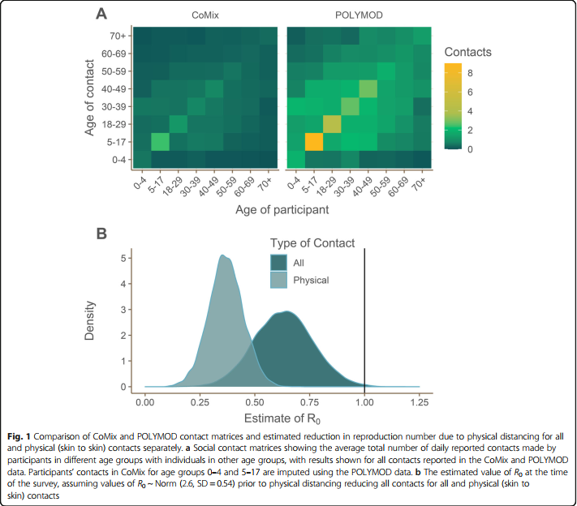
Estimation of R₀ (Jarvis, et al.) in the United Kingdom (UK)
R₀ is the potential of transmission of a disease
R₀ < 1 – each existing infection causes less than one new infection
R₀ = 1 – each existing infection causes one new infection
R₀ > 1 – each existing infection causes more than one new infection. May cause an outbreak or epidemic.
Participation data: survey data
1356 UK participants
Recorded 3849 contacts
R₀ prior to lockdown = 2.6
Current R₀ estimation (under current social distancing measures) – 0.62
95% Confidence Interval [CI] 0.37 – 0.89)
Based on all types of contact

Slide 9
Methodology
Participants
1,600 agent spectators
6' contact zone
Grouping behaviors
Food/bathroom behaviors
Materials / Apparatus
Anylogic agent model
Anylogic SIR model
Design
Dependent Variables
Infected agent contacts
SIR infection rate
Independent Variables
Atendence capacity
Attendee group size
SIR I0
Control
Mask Wearing
Procedure
See table
Expected Measure
Agent contacts
Infection rate

Slide 10
Example: Results table
RunNo. | Prob of Infection: [0.5 (no-mask), 0.25 (mask)] | Social-distancing (T/ F) | Group size (1,2,4) | Attendance | RESULTS (num of contacts) | RESULT (infections)
25
50
50<

Slide 11
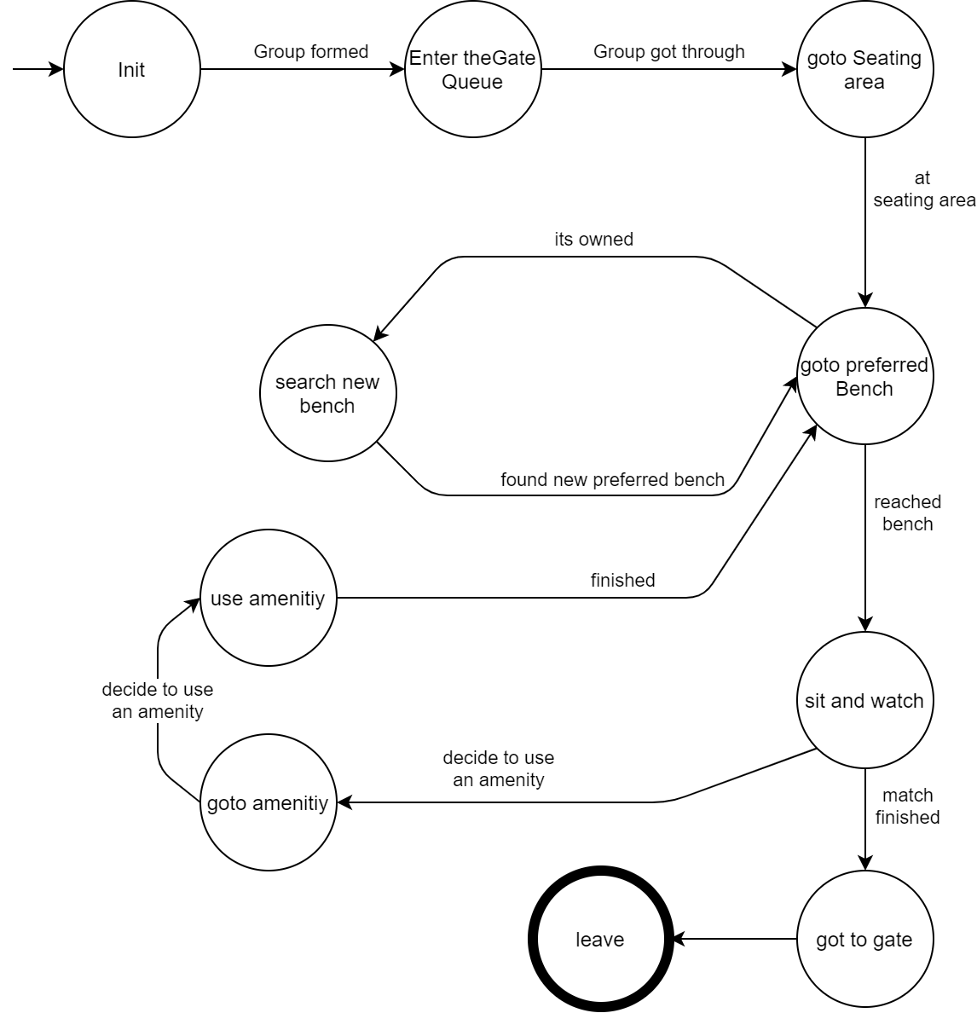
State Diagram of Agent

Slide 12
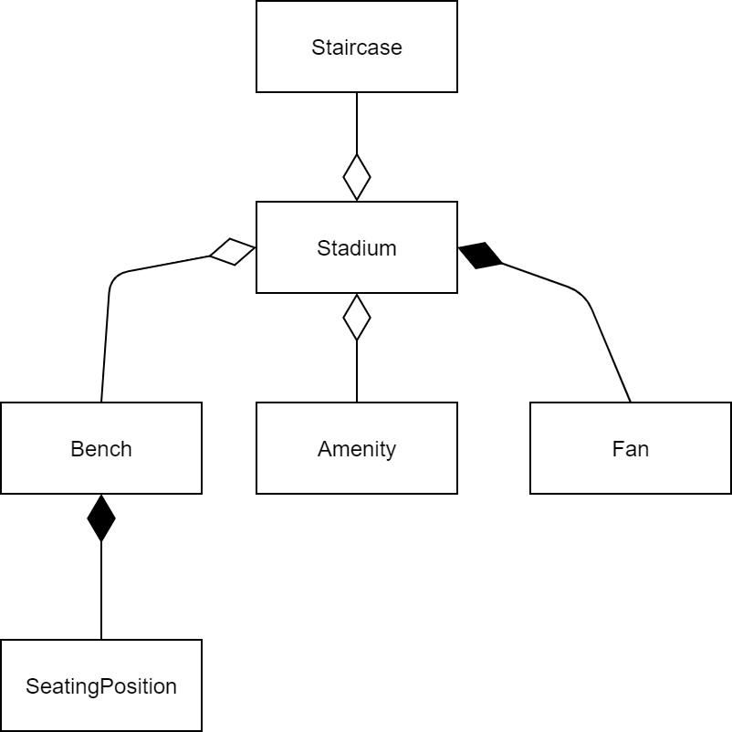
Class Diagram

Slide 13
Baseline Model
Demo

Slide 14
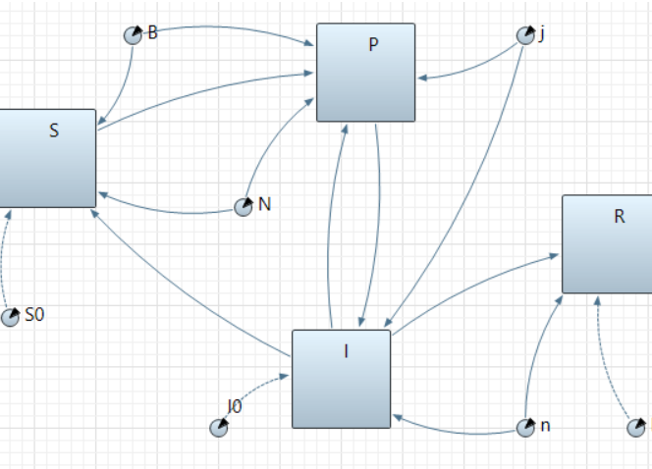
Transmission Modeling
Ro value based on number of contacts
Use SEIR model to find number of contact driven infections
Considering E, incubation period, limits secondary transmission.

